Slide 1

Project: Bank Loan Analysis
Mrs.Pradnya Vivek Rajmane

Slide 2
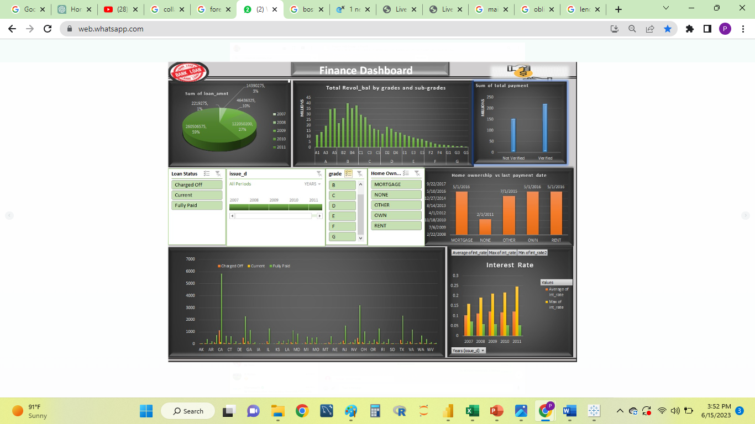
Excel

Slide 3
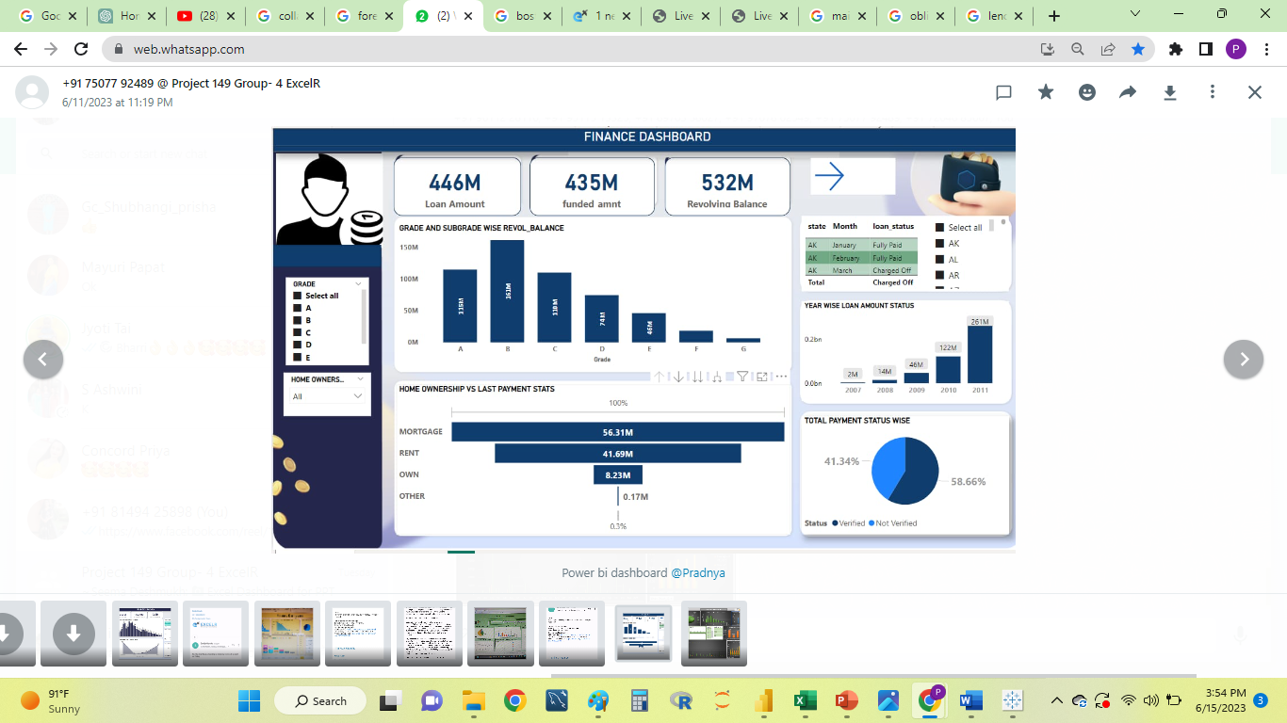
Power BI

Slide 4
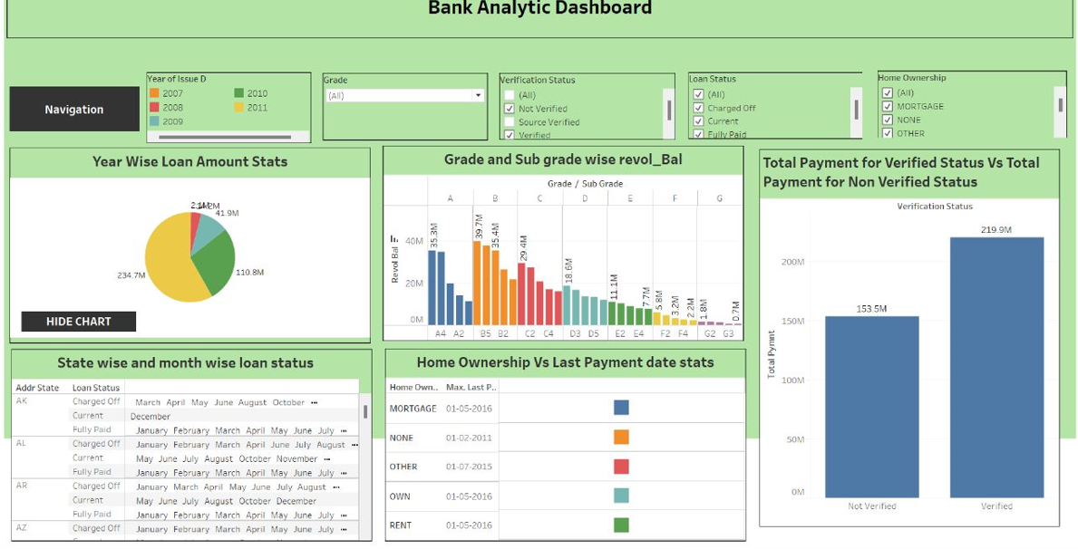
Tableau

Slide 5
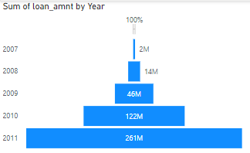



KPI 1 : Year wise Loan amount
 | In 2007 to 2008, significant increase in the loan amount subsequent years, the increase remained relatively steady with only a 2-3 fold increase
 | specific factors or events in 2008 Economic conditions, market factors, or specific initiatives taken during that period.
 | Assess the bank's marketing and sales strategies during the years of steady increase Monitor and manage their loan

Slide 6
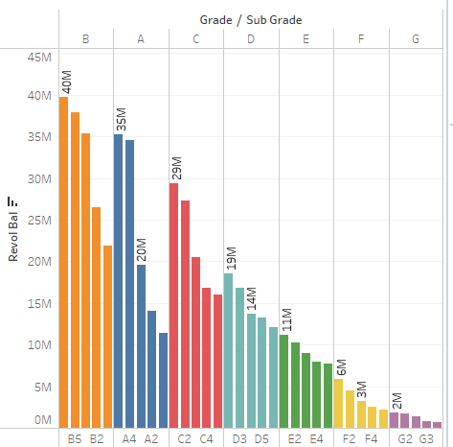
KPI 2 : Grade and sub-grade wise revolving balance
 | Grade B showed highest revolving balance Overall in all grade the revolving balance amount is more than the loan amount except grade G Grade G is availing loan credit more effectively than the other grades.
 | The borrower has not utilized the full available credit limit on their revolving credit account.
 | Provide education and guidance Offer incentives or rewards Strengthen customer relationships

Slide 7

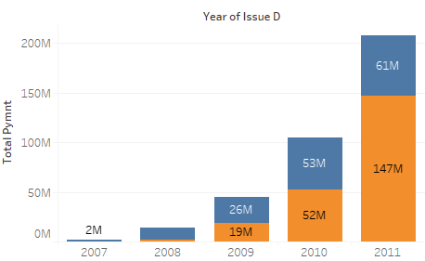

KPI 3 : Verified vs Non verified status
 | Verification status for loans was at 0% in 2007 and gradually increased to 66% by 2011
 | Initial weakness: The low verification status in 2007 indicates that banks had inadequate or less stringent verification processes Progressive improvement However, a 66% verification rate suggests that there is still room for improvement.
 | Compliance and fraud prevention: Ensure strict adherence to regulatory guidelines, such as KYC Continuous monitoring and improvement: effectiveness of verification processes

Slide 8
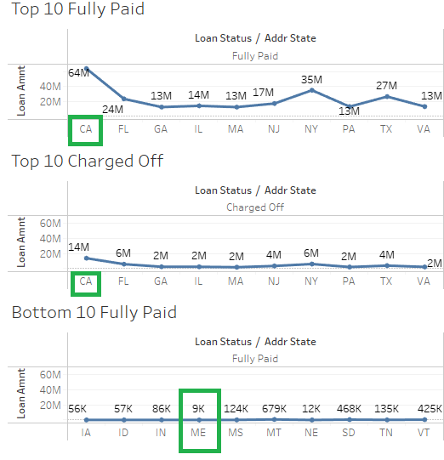
KPI 4 : State wise & month wise loan status
 | California (CA) has the highest amount of fully paid loans and charged off Maine : one record of fully paid loans and no charged-off loans in Maine for the year 2007
 | California have a relatively higher rate of successfully repaying their loans. It reflects a positive trend in loan repayment behavior in the state. Relatively lower loan activity in Maine state during year 2007 period.
 | Further investigate the reasons behind the higher percentage of charged-off loans in California Analyze the factors contributing to the lower loan activity in Maine Implement risk management strategies and credit monitoring practices to mitigate the risk of loan defaults and improve overall loan portfolio performance.

Slide 9
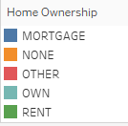
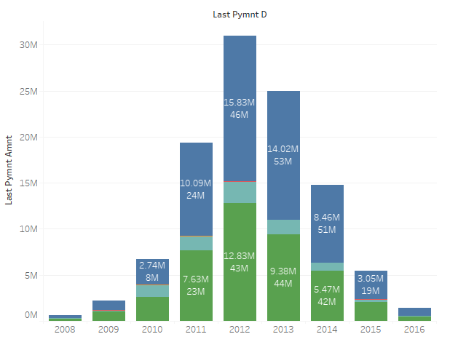
KPI 5 : Home ownership vs last payment date
 | In 2012, the last payment amount for mortgage and rent was $28.66 million over a loan amount of $89.83 million.
 | The last payment amount suggests that the borrower made a substantial effort to reduce their outstanding mortgage and rent obligations.
 | It would be beneficial to review the terms of the mortgage and rent agreement to understand the specific terms and conditions. Assess the borrower's financial situation to ensure their ability to make future payments and meet their obligations. Consider consulting with a financial advisor or mortgage professional to evaluate the borrower's options for optimizing their mortgage and rent payments.

Slide 10
Summary
A profit of $55 million on a $446 million loan amount
A profitability ratio of 12.34% suggests a reasonably favorable outcome
Charged off amount is $34M overall considering recovered payment and interest.
Purpose of loan is debt consolidation $237M over $446M total loan amount implies that the borrower intends to streamline their debt and simplify the repayment process.
Analyze the reasons for the charge-off: Investigate why a portion of the loan became uncollectible and evaluate the bank's risk assessment and credit management processes. Identify any potential improvements or adjustments needed.
Diversification: Consider diversifying the loan portfolio to minimize concentration risk. Spreading loans across various sectors, industries, or geographies can help reduce the impact of potential charge-offs on overall profitability.
Loan Recovery: Explore options for recovering a portion of the charged-off amount. This could involve engaging in debt collection efforts or negotiating settlements with borrowers, potentially reducing the loss for the bank.
Insights

